Slide 1
IBM University Engagement Project Submission
“Exploring the Power of Agentic AI with IBM Granite and LangFlow”

Slide 2

Project Tile – AI-Powered Interview Trainer Agent
Domain of Project – Education / Career Development
Student Name | Recent Passport Photo | Email ID | Mobile number [WhatsApp]
Sharupriya.G |  | sharupriyagopi1327@gmail.com | 8825519358

Slide 3
Problem Statement -
Problem Statement : Interview Trainer Agent
The ChallengeJob seekers often struggle to prepare effectively for interviews due to lack of personalized guidance, role-specific questions, and real-time answer feedback. Interview preparation resources are scattered and generic across the internet. Without personalized, AI-powered guidance, many candidates fail to perform well in competitive job interviews.
The Objective
Build an AI-powered Interview Trainer Agent that delivers personalized interview preparation and guidance for job seekers across all experience levels. The solution should:
Personalized Interview Questions – Generate role-specific questions based on job title, experience level, and uploaded resume.
RAG-Based Knowledge Retrieval – Retrieve role-specific interview knowledge using FAISS vector search with semantic similarity.
Answer Evaluation & Scoring – AI evaluates user answers and provides SCORE/10 with strengths, improvements, and model answers.
Practice Mode – Mock interview session with configurable number of questions, difficulty levels, and history tracking.
IBM Granite Integration – IBM granite-4-h-small model via WatsonX.ai powers all question generation and answer evaluation.
Resume Upload – PDF resume upload for personalized question generation based on candidate skills and experience.

Slide 4
Technology Used
Tech Stack (Mandatory)
Use any one of the following approaches:
LangFlow + IBM watsonx.ai + Granite Models
IBM Cloud Agentic Lab with IBM Granite Models
Replicate with LangChain + RAG + IBM Granite Models
I used: LangChain + RAG + IBM Granite Models (ibm/granite-4-h-small) + Streamlit + FAISS

Slide 5
Proposed Solution -
Proposed Solution: AI-Powered Interview Trainer Agent
The proposed solution is an AI-powered Interview Trainer Agent built using LangChain, FAISS RAG, IBM WatsonX.ai, and IBM Granite model to provide personalized, real-time interview preparation. The system addresses challenges in job interview preparation through an intelligent, modular architecture.
At its core, the solution uses a Retrieval-Augmented Generation (RAG) pipeline powered by FAISS vector search with HuggingFace Sentence Transformers embeddings (all-MiniLM-L6-v2). Interview knowledge documents are embedded and stored in a FAISS vector database, enabling semantic retrieval of role-specific context which is passed to IBM Granite for personalized response generation.
The system consists of three key modules:
Chat Module — Free conversation with IBM Granite AI. Users can ask anything about interview preparation and receive personalized answers based on their resume and job role.
Practice Mode — Structured mock interview session. Users configure role, question type, difficulty, and number of questions. AI generates questions automatically, evaluates answers, and provides SCORE/10 with strengths, improvements, and model answers.
Tips & Resources Module — Comprehensive interview preparation guides covering technical preparation, behavioral questions (STAR method), body language, salary negotiation, and resume tips.
The solution includes a professional Streamlit UI with sidebar profile setup, resume PDF upload, performance score tracking, and practice history management.
IBM WatsonX.ai powers model deployment and inference. IBM Granite model (granite-4-h-small) handles all question generation, answer evaluation, and personalized feedback generation.
Overall, this solution delivers an end-to-end intelligent interview preparation assistant that boosts candidate confidence through personalized questions, real-time AI feedback, and comprehensive scoring analytics.

Slide 6
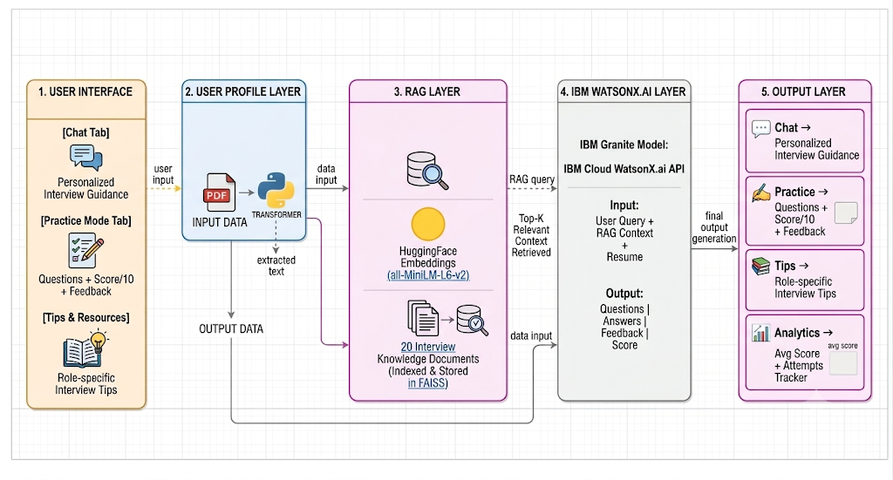
Architecture blueprint

Slide 7

Role of Agentic AI in the solution
Role of RAG in Interview Trainer Agent
RAG (Retrieval-Augmented Generation) enables the Interview Trainer Agent to function as an intelligent, knowledge-driven system rather than a simple chatbot. Using FAISS vector search and IBM Granite model via WatsonX.ai, it retrieves relevant interview knowledge before generating personalized responses.
When a user inputs their job role or question, FAISS performs semantic similarity search across 20 indexed interview knowledge documents. The most relevant context is retrieved and injected into the IBM Granite prompt for accurate, role-specific response generation.
RAG brings context awareness by retrieving role-specific knowledge — for example, Software Engineer interviews focus on System Design and Data Structures, while AI/ML Engineer interviews focus on Deep Learning, NLP, and TensorFlow. This ensures IBM Granite generates highly targeted and accurate interview questions, answers, and tips.
Additionally, the user's resume text is also injected into the RAG context, enabling hyper-personalized responses based on individual candidate skills and experience. The system continuously adapts based on user inputs like job role, experience level, and resume content.
Overall, RAG makes the Interview Trainer Agent accurate, personalized, and reliable — acting like a smart digital interview coach that helps candidates succeed in competitive job interviews through context-aware, knowledge-grounded AI responses.

Slide 8
Novelty and Uniqueness
The Interview Trainer Agent stands out by combining RAG, IBM Granite AI, and resume-based personalization into one intelligent system.
RAG-Powered Accuracy — FAISS semantic search retrieves role-specific knowledge for accurate, targeted responses.
Resume Personalization — PDF upload enables hyper-personalized questions based on candidate's actual skills.
Mock Interview + Scoring — AI evaluates answers with SCORE/10, strengths, improvements, and model answers.
Practice History — Session history saved after stopping for performance review and improvement tracking.
Multi-Tab Interface — Chat, Practice Mode, and Tips tabs — complete interview prep in one platform.
IBM Granite Compliant — Uses granite-4-h-small via WatsonX.ai — fully satisfies PS-22 mandatory requirement.
Deployed on Streamlit Cloud — Publicly accessible for easy mentor evaluation anywhere.
Configurable Sessions — Set questions count, difficulty, and type (Technical/Behavioral/HR/System Design).
This makes it a smart, proactive digital interview coach — not just a static question generator.

Slide 9
Git Hub Link
GitHub Repository URL:
GitHub: https://github.com/sharupriyagopi1327-dev/interview-trainer-agent
Live App: https://interview-trainer-agent.streamlit.app
Repository Contents:
app.py — Main application file
requirements.txt — Python dependencies
README.md — Project documentation
·
·
·

Slide 10
Future Scope
1. Voice-Based Mock Interview — Add speech-to-text and text-to-speech capabilities enabling candidates to practice verbal interview responses. AI will evaluate tone, clarity, and content for comprehensive interview coaching, making preparation more realistic and effective.
2. Advanced RAG with ChromaDB — Upgrade from FAISS to ChromaDB persistent vector database with dynamic document ingestion. This will allow adding new interview questions and company-specific data in real-time without restarting the application.
3. Multilingual Support — Add support for multiple languages (Tamil, Hindi, Telugu, etc.) making the Interview Trainer Agent accessible to diverse populations across India and enabling candidates to practice in their preferred language.
4. Company-Specific Interview Preparation — Integrate company-specific interview patterns and questions from top companies like Google, Amazon, Microsoft, and TCS, enabling targeted preparation for specific job applications.
·
·
·

Slide 11


